Slide 1
Math 769: Statistical Learning

Slide 2
Neural Networks
Shahrzad Jamshidi, PhD

Slide 3
Last Time
We discussed the aim k-means clustering—to group unlabeled data into a specified number of clusters.
We discussed the algorithm of the process as well.

Slide 4
Objectives
Describe the biological inspiration of artificial neurons.
Define key terms such as weights, bias, activation function, and hidden layer.
List some hyperparameters of neural network models.
List two activation functions commonly used in these networks.
List two ways the model variance is mitigated.
List two ways parameter convergence is improved.

Slide 5
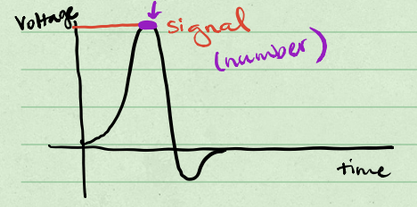
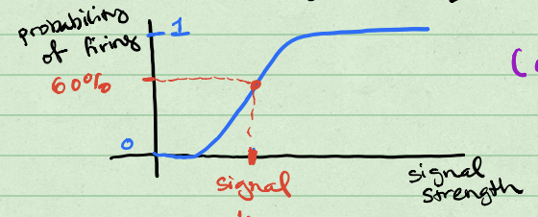
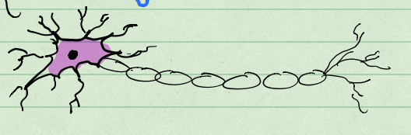
Modeling Neurons
Mathematical models from the 1950s provided a foundation for how biological neurons work.
One neuron would generate a potential. The following neuron would have a probability of firing based on the electrical potential.
Probability of also firing based on signal received
Potential = signal
Neuron sending signal
Neuron receiving signal

Slide 6
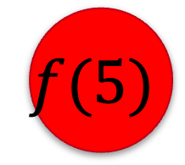
Artificial Neurons
Artificial neurons (ones that exist theoretically and are represented by computer calculations) are just entries in a vector.
Their connections (edges) represent transformations that can be sigmoid.
5
$$f(5)$$

Slide 7


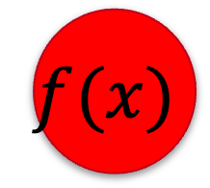
Weights, Bias, and Activation Function
The transformations between neurons follow a specific form:
$$f\left(x\right)= φ(wx+b)$$
where $w$ is the weight, $b$ is the bias, and $φ$ is the activation function.
$$x$$
$$f(x)$$

Slide 8
Weights, Bias, and Activation Function
Conceptually, the weight is how responsive neuron 2 is to the signals from neuron 1.
High weight means very responsive to signal; low weight means not responsive.
The bias represents a neuron’s general proclivity to send a signal.
$$x$$
$$f(x)$$

Slide 9




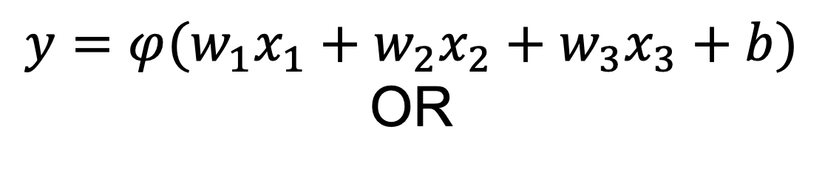


Layers
Neuronal models are organized into layers.
Each layer represents a vector; the entries of the vector are the values stored in the neuron.
$$x_{1}$$
$$y=φ(w_{1}x_{1}+w_{2}x_{2}+w_{3}x_{3}+b)$$
OR
$$\left(\begin{matrix}x_{1} \\ x_{2} \\ x_{3}\end{matrix}\right)$$
$$x_{2}$$
$$y=φ(w^{T}x+b)$$
$$x_{3}$$
$$y$$

Slide 10

Model Building
To use this framework to build a model for a dataset,
The first layer must correspond to the independent variables from your dataset (i.e., it must be p neurons).
The last layer must correspond to the dependent variable(s) from your dataset.
One can have any number of hidden layers (layers between the first and last layer) with any number of neurons.
Each neuron is defined by the layer of previous neurons:
$$y=φ(w^{T}x+b)$$

Slide 11



Hyperparameters in Model Building
The number of hidden layers in the model.
The number of neurons within each hidden layer.
The choice of activation function.
$$X_{1}$$
$$Y$$
$$X_{2}$$

Slide 12
More neurons and more layers means a more complex model!

Slide 13
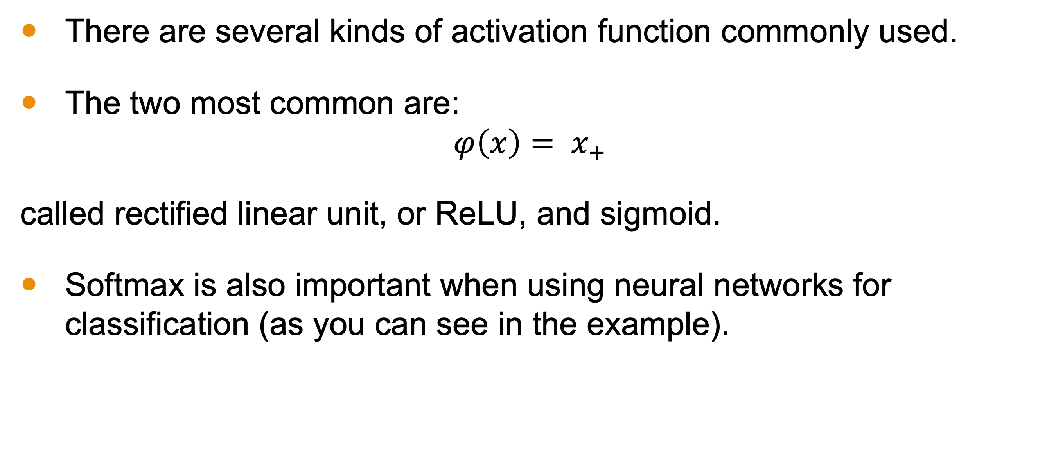
Activation Functions
There are several kinds of activation function commonly used.
The two most common are:
$$φ\left(x\right)= x_{+}$$
called rectified linear unit, or ReLU, and sigmoid.
Softmax is also important when using neural networks for classification (as you can see in the example).

Slide 14
High Variance Models
Because these models are high-variance, there are several techniques to avoid overfitting or “converging to a sub-optimal solution.”
Note: parameters (the weights and biases) are found using backpropagation, a method of gradient descent.
Review calc III and numerical analysis.

Slide 15
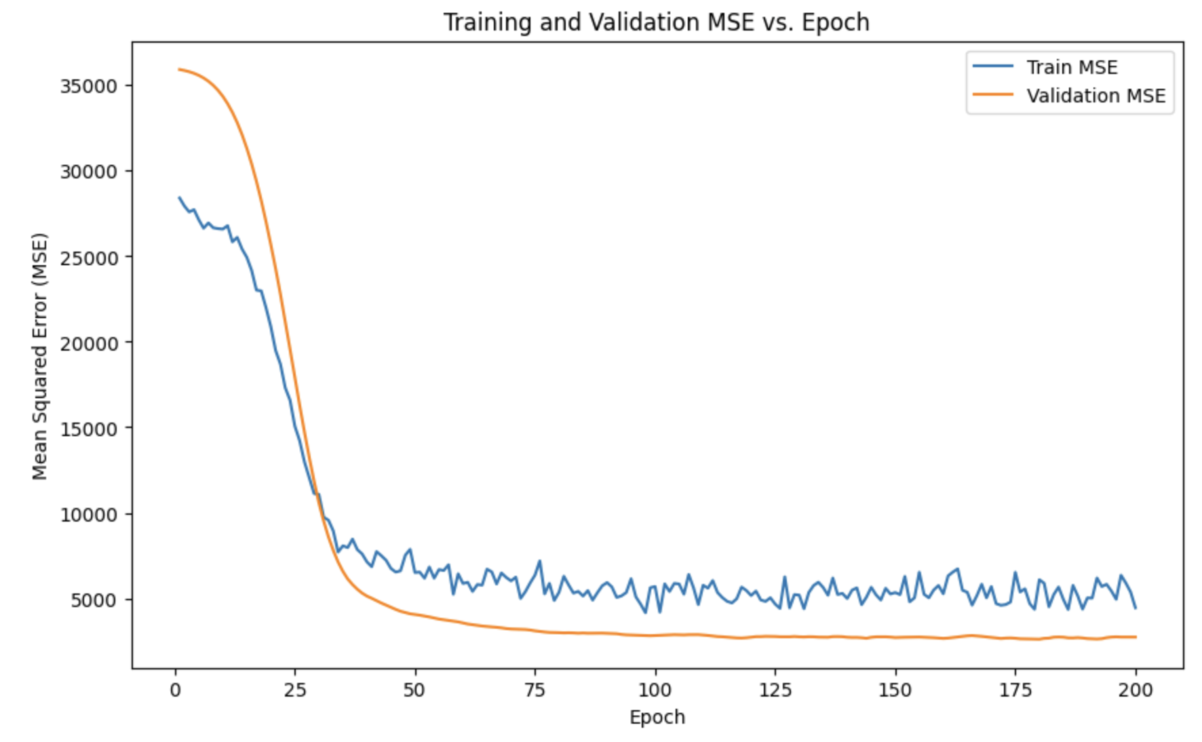
Managing Model Variance: Epochs
An epoch is one step in updating the parameters. Limiting the number of epochs will prevent overfitting.

Slide 16
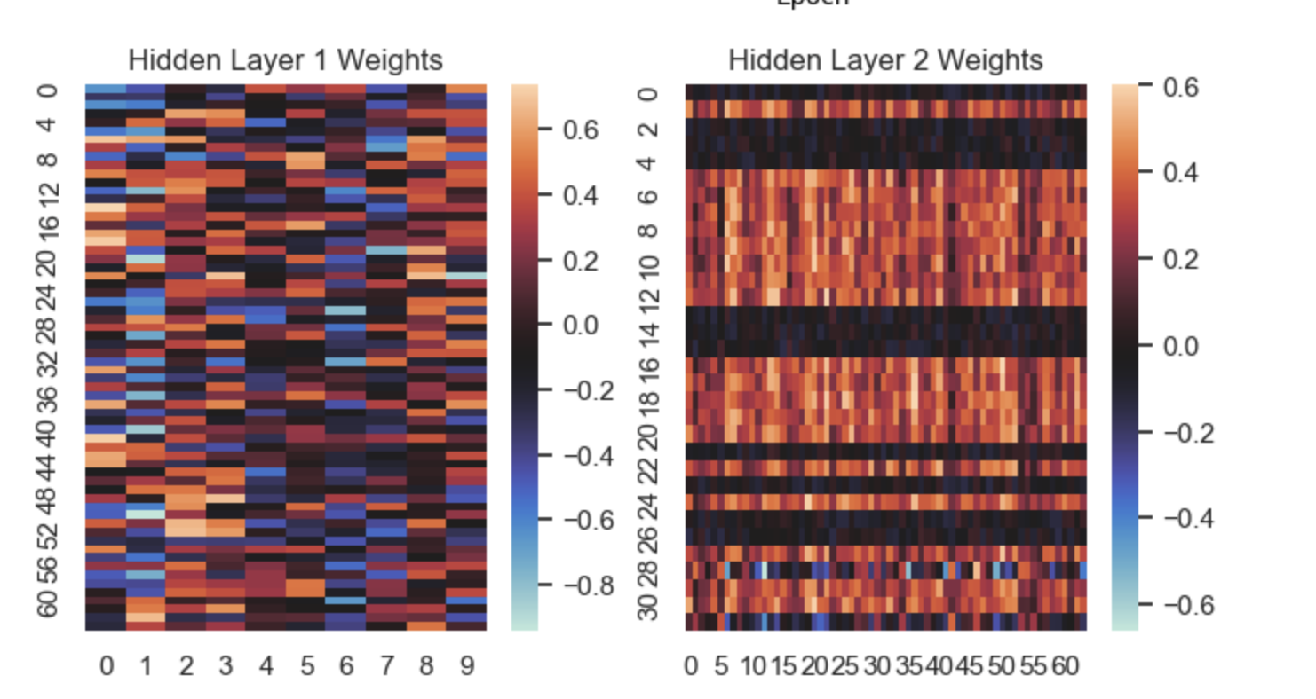
Managing Model Variance: Dropout
Dropout is a method of pushing some weights to 0 based on some threshold and/or probability.
This adds model bias and reduces variance.

Slide 17
Noise-Inducing Hyperparameters
Another set of techniques introduce noise into the process of updating parameters to improve convergence.
Batch size and optimizer are both hyperparameters that introduce noise into backpropagation to reduce the likelihood of converging to a suboptimal solution.
Batch size represents smaller folds the dataset is broken into; each fold goes through gradient descent sequentially within one epoch.
An optimizer is an algorithm for adjusting the gradient to manage convergence rate and direction.

Slide 18
Best Practices
Use only very large datasets.
Start with a simpler model to establish a baseline.
Use cross-validation for a robust estimate of model performance.
Gradually increase model complexity as needed.
Regularly monitor and tune hyperparameters.
Utilize GPU acceleration for faster training.

Slide 19
Conclusion
Neural networks are a versatile but high-variance model based on work modeling biological neurons.
They are constructed by picking layers, neurons per layer, and activation functions.
Hyperparameters like the number of epochs and dropout help manage some of the model variance.
Noise-inducing hyperparameters like batch-size and optimizers introduce noise to improve parameter convergence.

